Slide 1
Earthquake & Tsunami Risk Evaluation
By Keira Fludd, Jedidah Njoroge and Sulaiman Turey Mathew-Wilson

Slide 2
Data Selection & Introduction
This data was extracted from a kaggle dataset named Global Earthquake-Tsunami Risk Assessment Dataset. It contains over 700 recorded earthquakes varying between the richter magnitude scale of 6.5 to 9.0. This data also recorded if certain earthquakes caused tsunamis. There was over 478 tsunamis recorded and around 300 that could have potentially happened. This data was collected between January 2001 and December 2022 and contains no missing values and is 100% completed. Overall this data set is used for tsunami risk prediction, early warning systems, hazard markings and magnitude estimation.

Slide 3
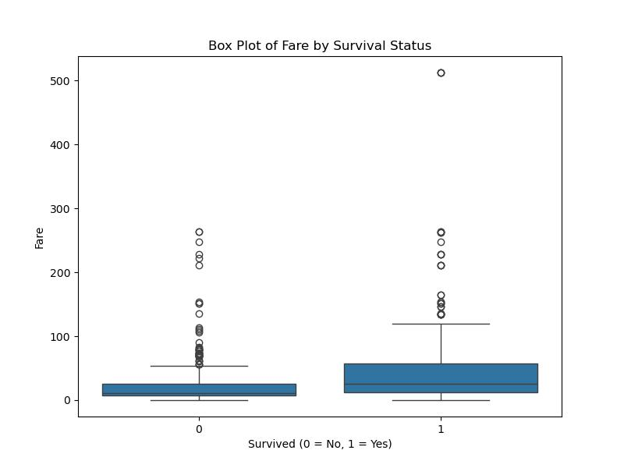
Data Wrangling
Cleaning: data had no missing or duplicate values
Structuring: no need to reorganize data into new format, all data types were consistent and formats were standardized
Column Guide:
  cdi = Community Decimal Intensity (the felt intensity) from 0 - 9
  mmi = Modified Mercalli Intensity, ranging from 1 - 9
  sig = Event significance score from 650 - 2910
  nst = Number of seismic monitoring stations from 0 - 934
  dmin = Distance to nearest seismic station 0.0 - 17.7

Slide 4
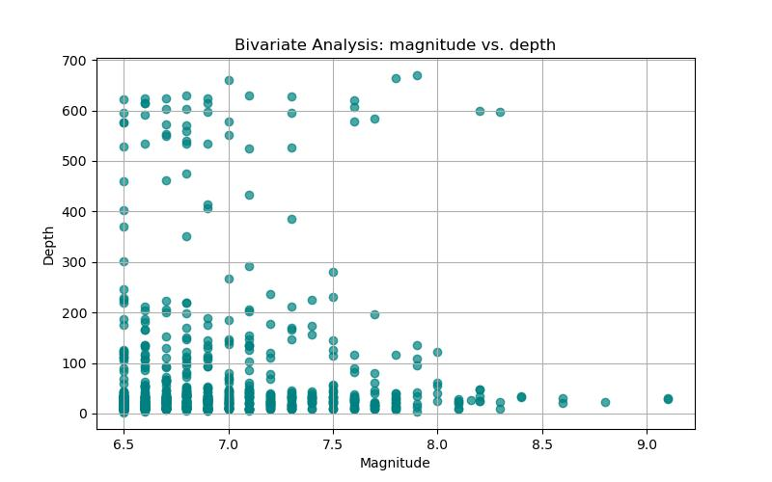
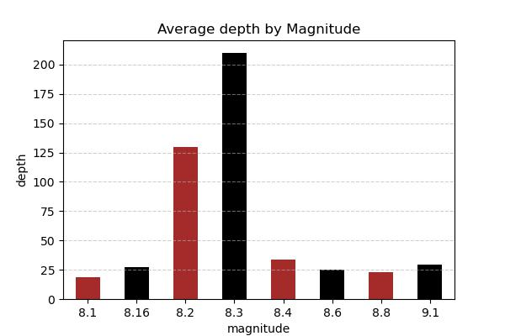
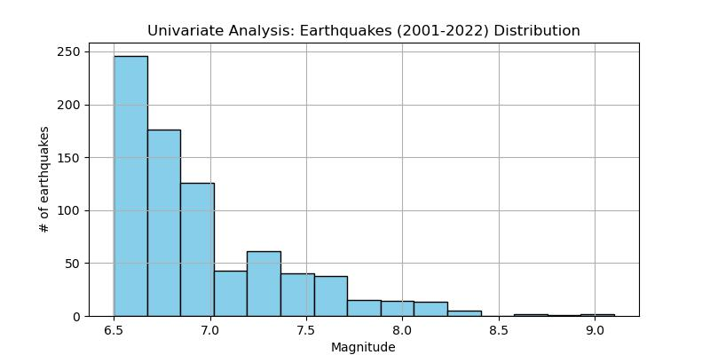
Earthquake Analysis
(Physical Damage)
These three graphs examine the relationship between physical destruction and various types of earthquakes. Some factors, like depth and magnitude, can influence the severity of destruction as some earthquakes that happen at higher depths but have low magnitudes can cause more destruction, Some of the earthquakes demonstrated extremely high magnitudes, they occurred at low depths.

Slide 5
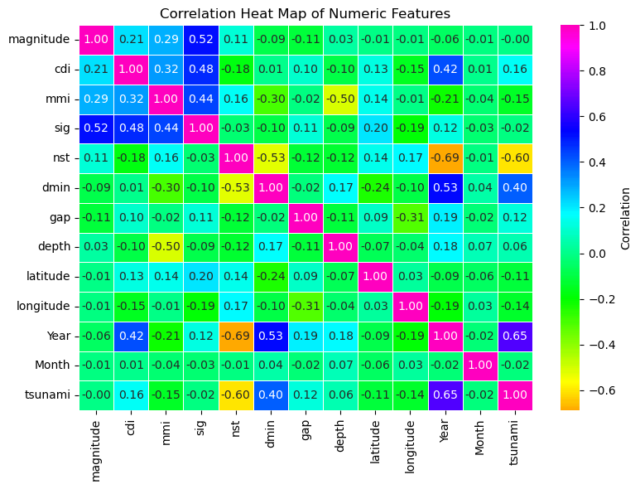
Overall Insight
Overall, there is no simple or single variable that directly predicts tsunami occurrence. A tsunami is not triggered by a single dominant factor but more so of an interaction of multiple conditions. Physical parameters such as magnitude, depth, and geographical coordinates such as latitude and longitude exhibit correlations that are either zero or weak.

Slide 6
Thank You

